Slide 1
Conditionals

Slide 2

The if Statement
Concept:
The if statement is used to create a decision structure, which allows a program to have more than one path of execution. The if statement causes one or more statements to execute only when a Boolean expression is true.
4-2
Notes:
2

Slide 3
The if Statement
A control structure is a logical design that controls the order in which a set of statements execute.
A sequence structure is a set of statements that execute in the order that they appear.
A decision (or selection) structure is a control structure that can execute a set of statements and perform a specific action only if a certain condition exists.
4-3
Notes:
3

Slide 4
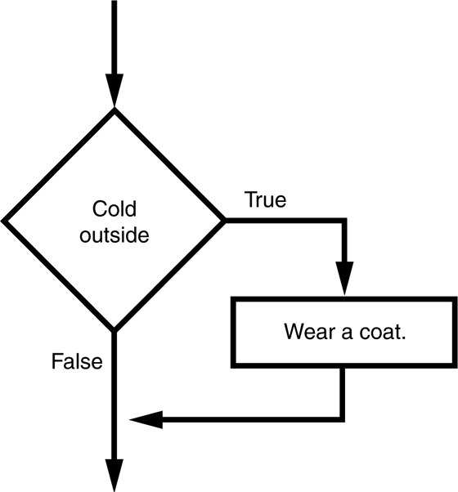
The if Statement
Decision (selection) structure:
Diamond symbol represents a true/false condition
Single alternative decision structure provides only one alternative path of execution.
A simple decision structure
4-4
Notes:
4

Slide 5
The if Statement
Decision (selection) structure:
In Python …
if condition:
statement
statement
statement
etc.
4-5
Notes:
5

Slide 6
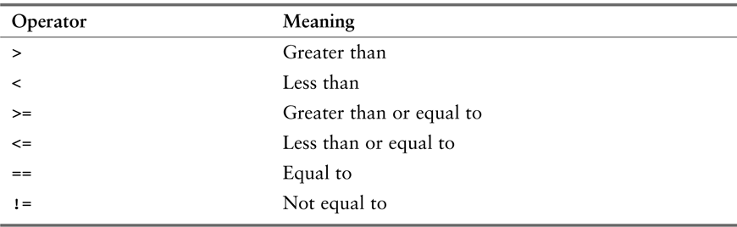
The if Statement
Boolean Expressions and Relational Operators
A relational operator determines whether a specific relationship exists between two values.
Relational operators
4-6
Notes:
6

Slide 7
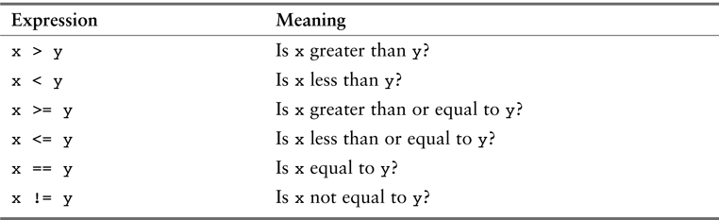
The if Statement
Boolean Expressions and Relational Operators
Boolean expressions using relational operators
4-7
Notes:
7

Slide 8

The if-else Statement
Concept:
An if-else statement will execute one block of statements if its condition is true, or another block if its condition is false.
4-8
Notes:
8

Slide 9
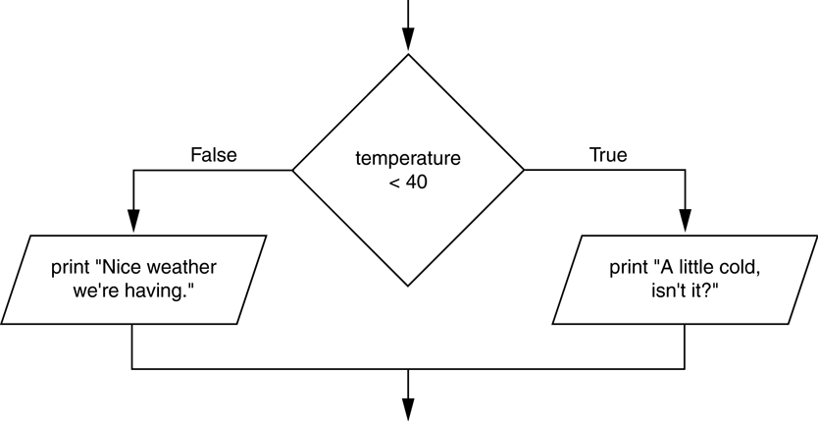
The if-else Statement
A dual alternative decision structure provides two possible paths of execution – one path is taken if a condition is true, and the other path is taken if the condition is false.
A dual alternative decision structure
4-9
Notes:
9

Slide 10
The if-else Statement
Dual alternative
In Python …
if condition:
statement
statement
etc.
else:
statement
statement
etc.
4-10
Notes:
10

Slide 11
Nested Decision Structures and the if-elif-else Statement
Concept:
To test more than one condition, a decision structure can be nested inside another decision structure.
4-11
Notes:
11

Slide 12
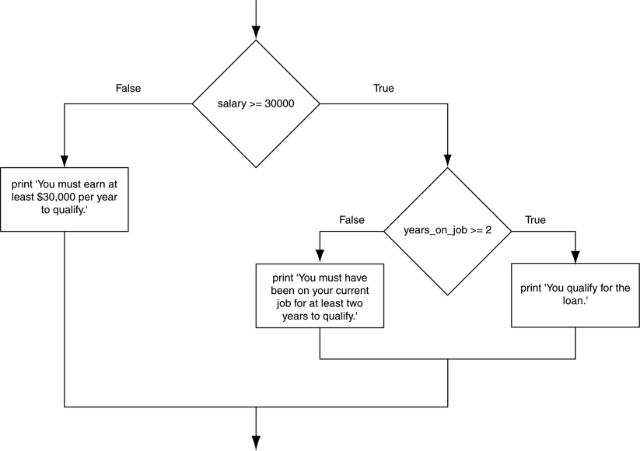
Nested Decision Structures and the if-elif-else Statement
A nested decision structure
4-12
Notes:
12

Slide 13
Nested Decision Structures and the if-elif-else Statement
if condition_1:
statement
statement
etc.
elif condition_2:
statement
statement
etc.
else:
statement
statement
etc.
The if-elif-else Statement
4-13
Notes:
13

Slide 14

Logical Operators
Concept:
The logical and operator and the logical or operator allow you to connect multiple Boolean expressions to create a compound expression. The logical not operator reverses the truth of a Boolean expression.
4-14
Notes:
14

Slide 15
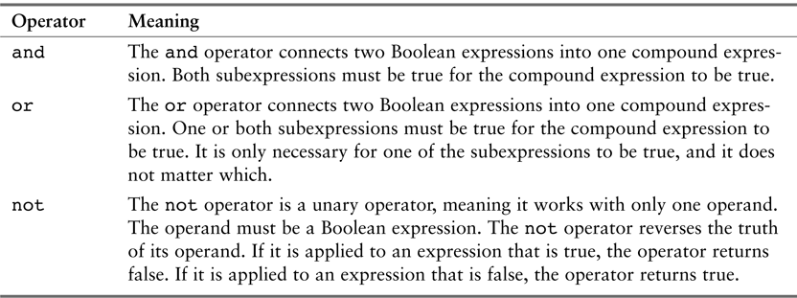
Logical Operators
Logical operators
4-15
Notes:
15

Slide 16
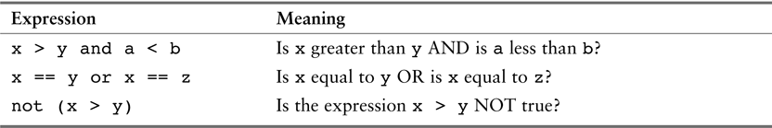
Logical Operators
Compound Boolean expressions using logical operators
4-16
Notes:
16

Slide 17
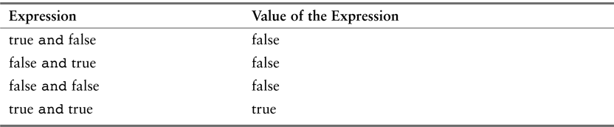
Logical Operators
The and Operator
Truth table for the and operator
if temperature < 20 and minutes > 12:
print ‘The temperature is in the danger zone.’
4-17
Notes:
17

Slide 18
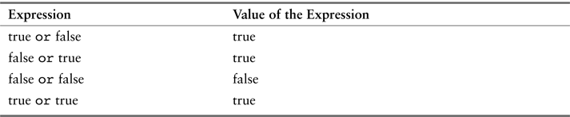
Logical Operators
The or Operator
Truth table for the or operator
if temperature < 20 or temperature > 100:
print ‘The temperature is too extreme.’
4-18
Notes:
18

Slide 19
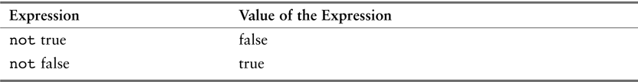
Logical Operators
The not Operator
Truth table for the not operator
if not(temperature > 100):
print ‘This is below the maximum temperature.’
4-19
Notes:
19

Slide 20

Boolean Variables
Concept:
A Boolean variable can reference one of two values: True or False. Boolean variables are commonly used as flags, which indicate whether a specific condition exists.
4-20
Notes:
20

Slide 21
Boolean Variables
if sales >= 50000:
sales_quota_met = True
else:
sales_quota_met = False
if sales_quota_met == True:
print ‘You have met your sales quota!.’
OR
if sales_quota_met:
print ‘You have met your sales quota!.’
4-21
Notes:
21

Slide 22
Iteration and Repetition

Slide 23

Introduction to Repetition Structures
Concept:
The repetition structure causes a statement or set of statements to execute repeatedly.
Notes:
23

Slide 24
Introduction to Repetition Structures
Condition-Controlled and Count-Controlled Loops
A condition-controlled loop uses a true/false condition to control the number of times that it repeats.
A count-controlled loop repeats a specific number of times.
Notes:
24

Slide 25

The while Loop: a Condition-Controlled Loop
Concept:
A condition-controlled loop causes a statement or set of statements to repeat as long as a condition is true. In Python you use the while statement to write a condition-controlled loop.
Notes:
25

Slide 26
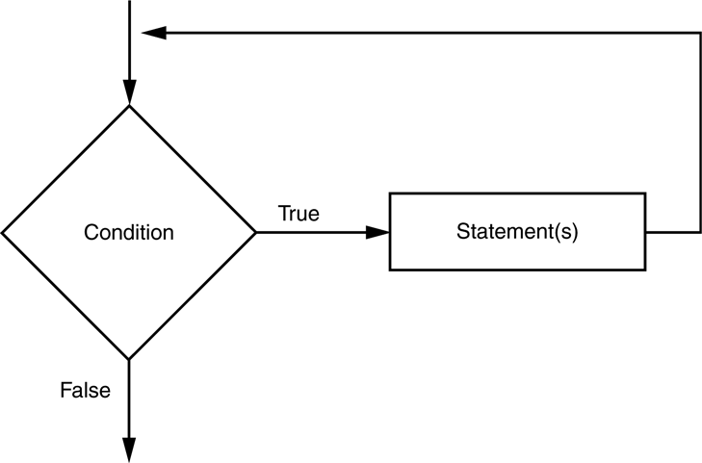
The while Loop: a Condition-Controlled Loop
In Python …
while condition:
statement
statement
etc.
The logic of a while loop
# Example from Micro:Bit
while True:
display.scroll(“Hi!”)
Notes:
26

Slide 27
The while Loop: a Condition-Controlled Loop
The while Loop is a Pretest Loop, which means it tests its condition before performing an iteration.
Note – most microcontrollers will have the majority of their code within a while True: loop! This keeps the device in a state of constantly running your code. In most other cases, e.g. web development, data mining scripts, we do not want this as this creates an infinite loop!
Notes:
27

Slide 28

The for Loop: a Count-Controlled Loop
Concept:
A count-controlled loop iterates a specific number of times. In Python you use the for statement to write a count-controlled loop.
Notes:
28

Slide 29
The for Loop: a Count-Controlled Loop
In Python …
for variable in [value1, value2, etc.]:
statement
statement
etc.
Notes:
29

Slide 30
The for Loop: a Count-Controlled Loop
Using the range Function with the for Loop
for num in range(1, 10, 2):
print(num)
First argument, 1, is the starting value for the list
Second argument, 10, is the ending limit of the list
Third argument, 2, is the step value
Notes:
30

Slide 31

Nested Loops
Concept:
A loop that is inside another loop is called a nested loop.
Notes:
31

Slide 32
Nested Loops
for hours in range(24):
for minutes in range(60):
for seconds in range(60):
print hours, ‘:’, minutes, ‘:’, seconds
About Nested Loops:
The inner loop goes through all of its iterations for every single iteration of the outer loop
Inner loops complete their iterations faster than outer loops
Notes:
32

Slide 33
Exercises
Conditionals and Iteration

Slide 34

Coin Toss on the Micro:Bit
Exercise - Write a Python program for your Micro:Bit that simulates 10 tosses of a coin.
Then output the results - e.g. Got 4 heads, 6 tails - to the user
Hint – we can use the random library’s randint function to give us a random number:
import random
…
myrandnum = random.randint(1, 2)
Go Further – Repeat the series of 10 tosses anytime the user shakes the device, using the gesture functions

Slide 35
Heartbeat Exercise
Exercise - Create a realistic heartbeat animation on your Micro:Bit’s screen using display(Image.HEART)
Tip: the resting human heartbeat is typically between 60 and 80 beats per minute (bpm)
Go Further - Modify your code with the following:
Pushing Button_A or shaking the device speeds up your heartbeat
Pushing Button_B slows down your heartbeat (but don’t let it stop entirely!)

Slide 36
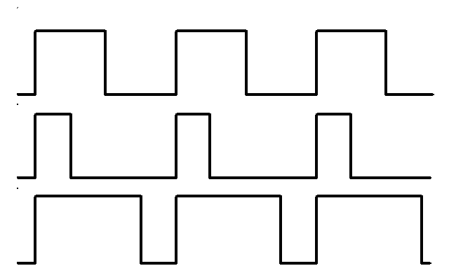
Pulse-Width Modulation (PWM) and write_analog()
A servo motor can rotate to and hold a specific angle until it is told to rotate to a different angle
You can control the angle of the servo by sending it a PWM (Pulse Width Modulation) signal which is mapped to a specific angle from 0 to 180 degrees.
Diagram of 3 different PWM signals – all of them have the same period (and thus frequency), but they have different duty cycles, i.e. how long power is on and off

Slide 37
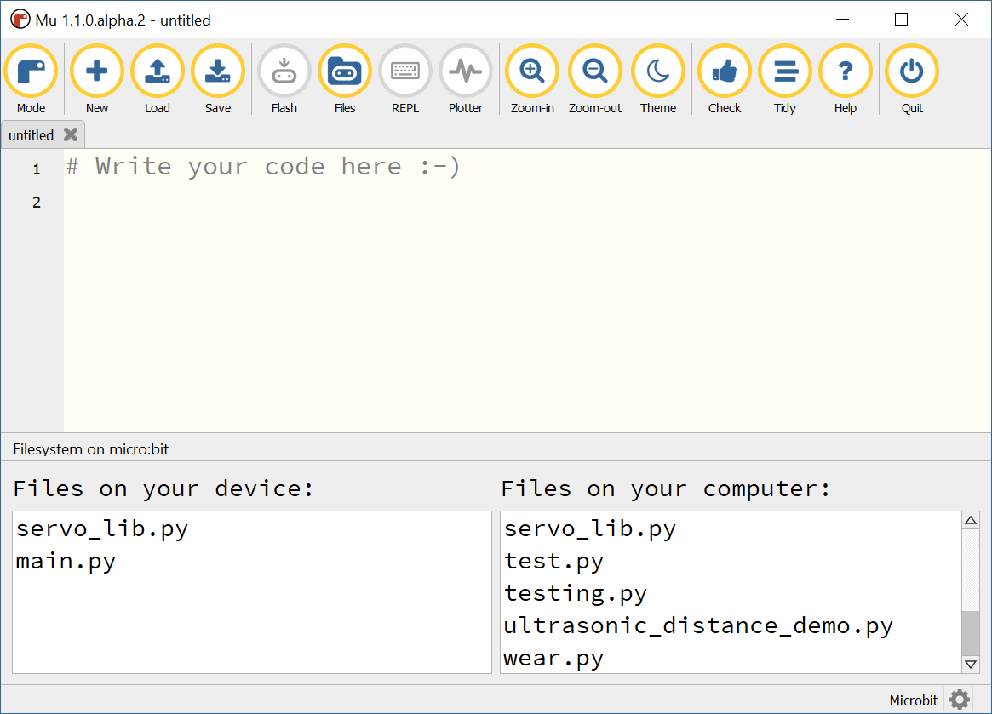
Servo Example
Files
Servos (and other examples) are often easiest to work with with an additional software library, here’s one for servo:
https://raw.githubusercontent.com/Pratt-Institute/info697/master/servo_lib.py
To load a library, we must place the library Python file on our Microbit, before we write code using it.
Do this using the Files menu in Mu Editor; drag the library file from your computer (on the right) to the Microbit (on the left)
Drag servo_lib.py from right to left to copy to MB

Slide 38
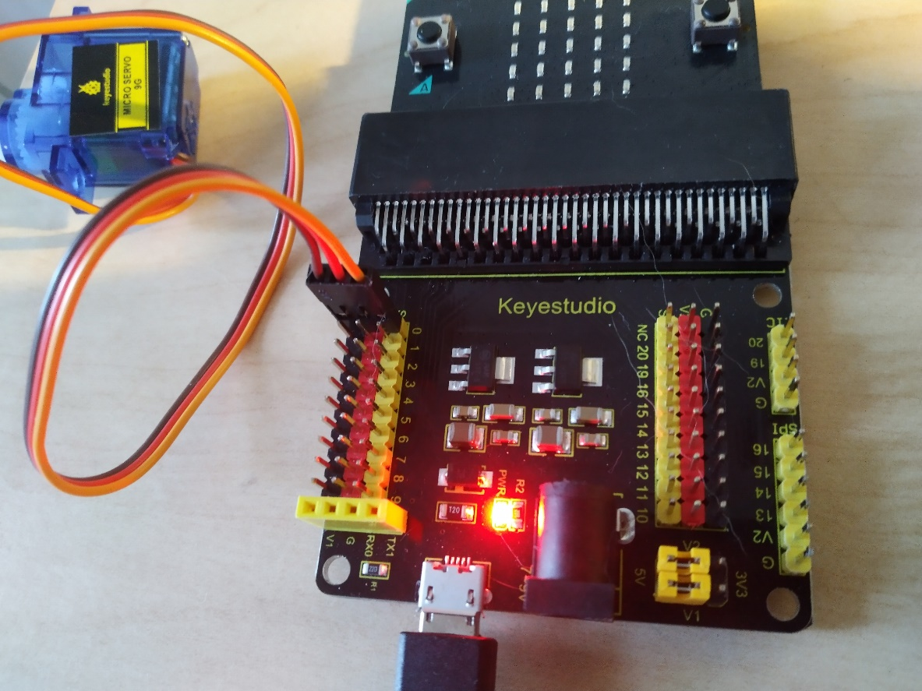
Wire and Run Servo
https://raw.githubusercontent.com/Pratt-Institute/info697/master/servo_demo.py
Note - you need an additional power USB cable attached at the bottom of the extension shield
from servo_lib import *
# Start at 0 degrees
Servo(pin0).write_angle(0)
sleep(1000)
while True:
Servo(pin0).write_angle(0)
sleep(1000)
Servo(pin0).write_angle(90)
sleep(1000)
Servo(pin0).write_angle(180)
sleep(1000)

